Slide 1
● THORWALLET TEAM OFF-SITE
Let’s build
together.
THORWallet
Roadmap, focus themes, and each other.
MON – WED

Slide 2
Agenda
Schedule: Mon–Wed
Thorwallet Roadmap Update
1
2
MINE
Focus Theme: AI
3
4
Focus Theme: Last Mile
Focus: 1:1
5
6

Slide 3
Schedule Mon–Wed
DAY 1
Monday
Kick-off & Roadmap
DAY 2
Tuesday
Focus Themes
DAY 3
Wednesday
People & Wrap-up
Welcome & goals
Thorwallet Roadmap update
MINE
Working sessions
Group activity 5-6:30pm
Focus Theme: AI
Focus Theme: Last Mile
Focus: 1:1s
Working sessions
Team Dinner - Illuminarium
Focus: 1:1s
Working sessions
Action items & owners
Retro & feedback
Close-out

Slide 4
Thorwallet Roadmap
WHERE WE STAND
WHAT WE’RE DRIVING
HOW WE WIN
Closing in on a genuine top-5 wallet
Recognised as an OG wallet — earned trust
Market consolidating as peers fade (CTRL, Leap)
Finishing the hard last 10% (led by Pedro)
Embedding AI wherever it drives efficiency
Security as a non-negotiable
Swap as our core revenue engine
Card as the second pillar
No shortcuts — every feature works, every time

Slide 5
MINE:
an AI-first lab.
● FOCUS THEME
A simple, self-custody money app for fintech users who don’t know crypto or gas — and our fastest way to test ideas.
What it is
AI-first test app
Branding ready from day one
Deliberately a “simple version”
Why it exists
Fewer users & dependencies
AI ships cheaper with Swift
Fintech-first, crypto-invisible
Card first approach
Early traction
~6K unique visitors / month
700 organic downloads
Mostly new users — not from Thorwallet
Independence is Mine.
mine.financial

Slide 6
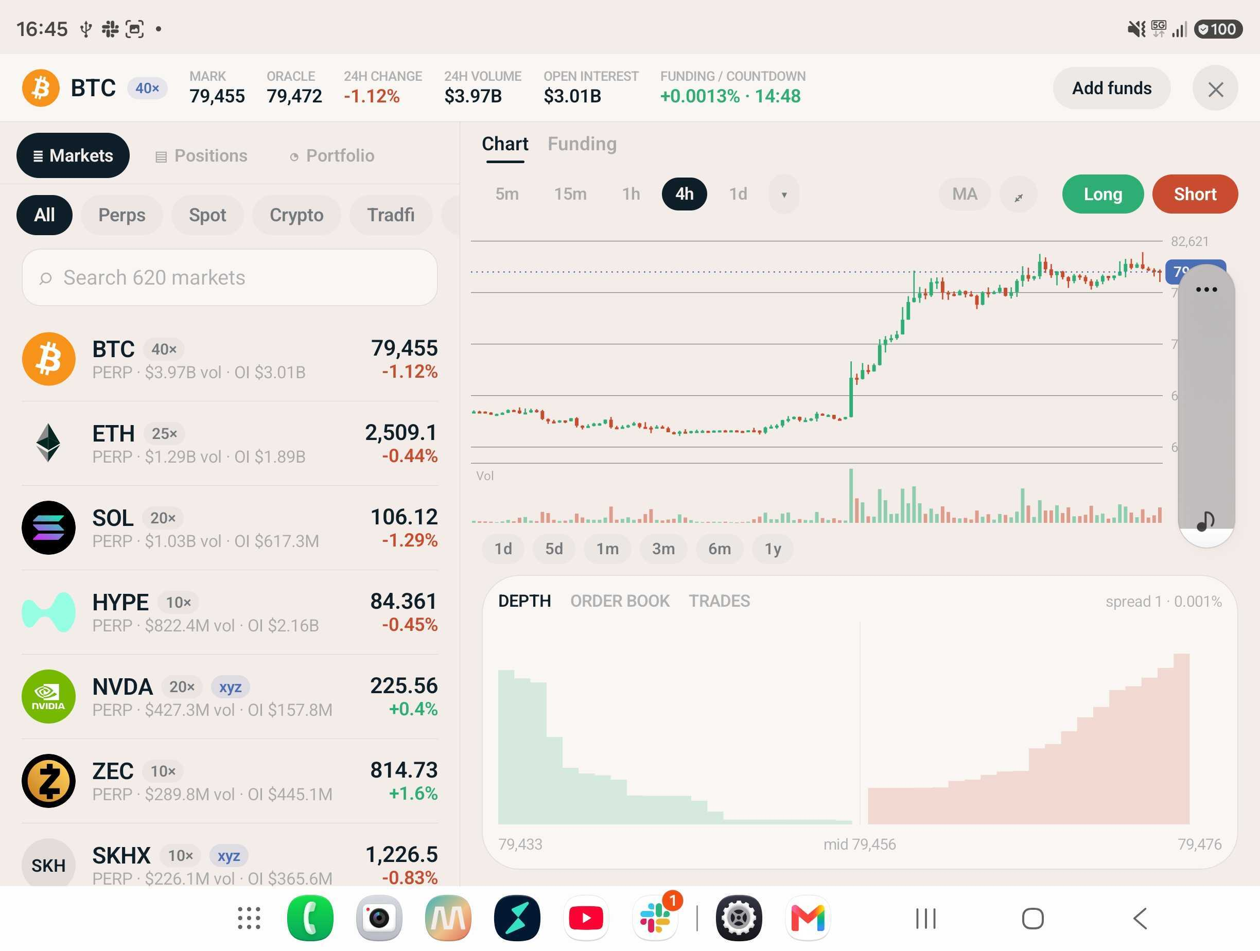
MINE:
what we’re testing.
● FOCUS THEME
Fast experiments — the winners port to Thorwallet.
✓ KYC changes & tests
✓ Expanding Ondo stocks functionality
✓ Gasless payments option (EVM)
✓ Mt Pelerin EUR & CHF IBAN
✓ Hyperliquid integration
Two-pane layout on foldables & tablets
✓ Screen layout: table & foldable
Independence is Mine.
mine.financial

Slide 7
Focus Theme: AI
Everyone gets a $100 Claude Team account
Let’s take 10 minutes to share best practices — here’s my current workflow:
Plan & implement
Plan with Fable (ultracode)
Implement with Fable 4.8 Max
ultracode when credits remain
Leave Fable 5 out of the build
Overnight builds
Fable 5 ultracode, 5-hour windows
When credits allow (~once a week)
e.g. first version of Hyperliquid
Design
Design work → Fable 5 only
Kept separate from build models

Slide 8
Focus Theme: Last Mile
From ‘almost done’ to shipped — led by Pedro

Slide 9
Focus: 1:1
Time to connect one-on-one — feedback, growth, and support
How it works
Paired 1:1 slots
~30 min each
What to talk about
Wins & challenges
Growth & goals
Feedback both ways
Come prepared
One thing going well
One thing to improve
One ask or need

